Slide 1
Regression Models

Slide 2
Regression models
The regression models help us forecast the time series values based on their relationship with external predictor variables.
These models can capture both trend and seasonality.

Slide 3
Regression Models With Trend

Slide 4
Regression models with trend
These models use two variables:
a forecasted variable (dependent variable), which consists of the time series values
a predictor (or independent variable), which consists of a time index

Slide 5
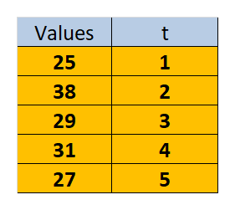
Regression models with trend

Slide 6
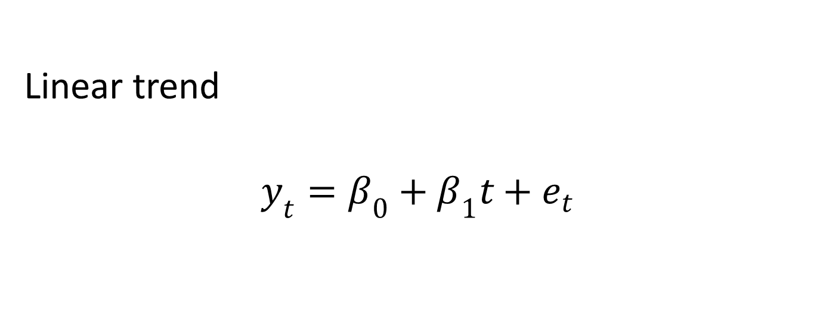
Regression models with trend
Linear trend
$$y_{t}=β_{0}+β_{1}t+e_{t}$$

Slide 7
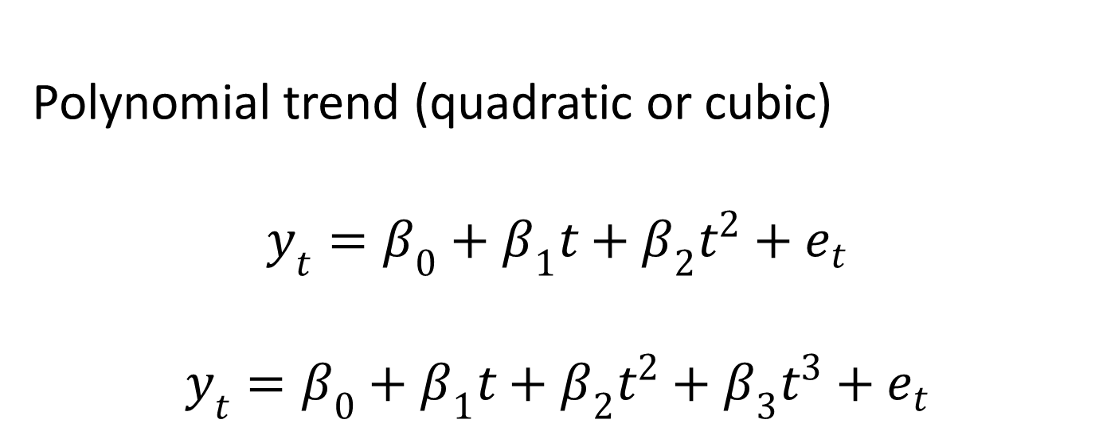
Regression models with trend
Polynomial trend (quadratic or cubic)
$$y_{t}=β_{0}+β_{1}t+β_{2}t^{2}+e_{t}$$
$$y_{t}=β_{0}+β_{1}t+β_{2}t^{2}+β_{3}t^{3}+e_{t}$$

Slide 8
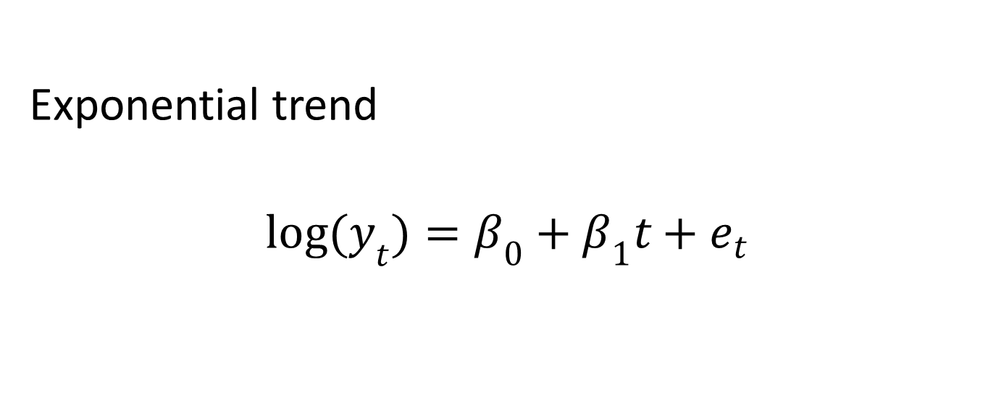
Regression models with trend
Exponential trend
$${log(y}_{t})=β_{0}+β_{1}t+e_{t}$$

Slide 9
Regression Models With Trend and Seasonality

Slide 10
Regression models with trend and seasonality
To account for seasonality, we first create a categorical variable that represents the season for each value.
Next, we convert this variable into a set of dummy variables. These variables will be our predictors.

Slide 11
Regression models with trend and seasonality
If we have M seasonal periods in our series, we need M-1 dummy variables.
Each variable is equal to 1 when the corresponding value falls into that season and equal to zero otherwise.

Slide 12
Regression models with trend and seasonality
For example:
if we have a seasonal cycle of 12 months, we create 11 dummy variables
if our cycle length is 7 days, we need 6 dummy variables

Slide 13
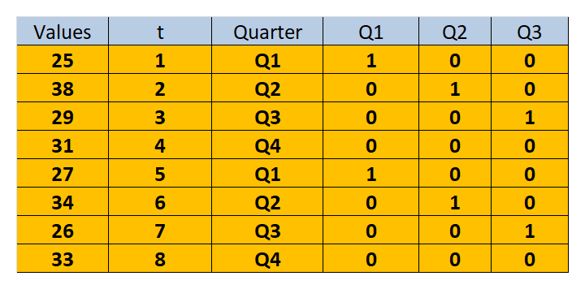
Regression models with trend and seasonality

Slide 14
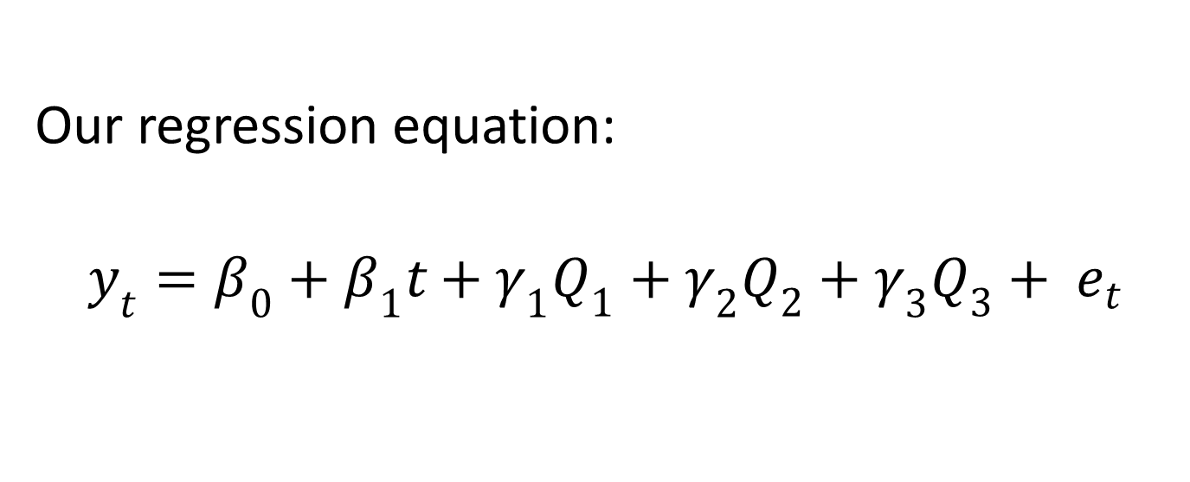
Regression models with trend and seasonality
Our regression equation:
$$y_{t}=β_{0}+β_{1}t+γ_{1}Q_{1}+γ_{2}Q_{2}+γ_{3}Q_{3}+ e_{t}$$

